Slide 1
Chapter 21 - C++ Stream Input/Output
Outline
21.1 Introduction
21.2 Streams
21.2.1 Iostream Library Header Files
21.2.2 Stream Input/Output Classes and Objects
21.3 Stream Output
21.3.1 Stream-Insertion Operator
21.3.2 Cascading Stream-Insertion/Extraction Operators
21.3.3 Output of char * Variables
21.3.4 Character Output with Member Function put; Cascading puts
21.4 Stream Input
21.4.1 Stream-Extraction Operator
21.4.2 get and getline Member Functions
21.4.3 istream Member Functions peek, putback and ignore
21.4.4 Type-Safe I/O
21.5 Unformatted I/O with read, gcount and write

Slide 2
Chapter 21 - C++ Stream Input/Output
Outline (continued)
21.6 Stream Manipulators
21.6.1 Integral Stream Base: dec, oct, hex and setbase
21.6.2 Floating-Point Precision (precision, setprecision)
21.6.3 Field Width (setw, width)
21.6.4 User-Defined Manipulators
21.7 Stream Format States
21.7.1 Format State Flags
21.7.2 Trailing Zeros and Decimal Points (ios::showpoint)
21.7.3 Justification (ios::left, ios::right, ios::internal)
21.7.4 Padding (fill, setfill)
21.7.5 Integral Stream Base (ios::dec, ios::oct, ios::hex, ios::showbase)
21.7.6 Floating-Point Numbers; Scientific Notation (ios::scientific, ios::fixed)
21.7.7 Uppercase/Lowercase Control (ios::uppercase)
21.7.8 Setting and Resetting the Format Flags (flags, setiosflags, resetiosflags)
21.8 Stream Error States
21.9 Tying an Output Stream to an Input Stream

Slide 3
Objectives
In this chapter, you will learn:
  To understand how to use C++ object-oriented stream input/output.
  To be able to format inputs and outputs.
  To understand the stream I/O class hierarchy.
  To understand how to input/output objects of user-defined types.
  To be able to create user-defined stream manipulators.
  To be able to determine the success or failure of input/output operations.
  To be able to tie output streams to input streams.

Slide 4
21.1 Introduction
Many C++ I/O features are object-oriented
  Use references, function overloading and operator overloading
C++ uses type safe I/O
  Each I/O operation is automatically performed in a manner sensitive to the data type
Extensibility
  Users may specify I/O of user-defined types as well as standard types

Slide 5
21.2 Streams
Stream
  A transfer of information in the form of a sequence of bytes
I/O Operations:
  Input: A stream that flows from an input device ( i.e.: keyboard, disk drive, network connection) to main memory
  Output: A stream that flows from main memory to an output device ( i.e.: screen, printer, disk drive, network connection)

Slide 6
21.2 Streams
I/O operations are a bottleneck
  The time for a stream to flow is many times larger than the time it takes the CPU to process the data in the stream
Low-level I/O
  Unformatted
  Individual byte unit of interest
  High speed, high volume, but inconvenient for people
High-level I/O
  Formatted
  Bytes grouped into meaningful units: integers, characters, etc.
  Good for all I/O except high-volume file processing

Slide 7
21.2.1 Iostream Library Header Files
iostream library:
  <iostream.h>: Contains cin, cout, cerr and clog objects
  <iomanip.h>: Contains parameterized stream manipulators

Slide 8
21.2.2 Stream Input/Output Classes and Objects
ios:
  istream and ostream inherit from ios
    iostream inherits from istream and ostream.
<< (left-shift operator)
  Overloaded as stream insertion operator
>> (right-shift operator)
  Overloaded as stream extraction operator
  Both operators used with cin, cout, cerr, clog, and with user-defined stream objects

Slide 9
21.2.2 Stream Input/Output Classes and Objects
Figure 21.1 Portion of the stream I/O class hierarchy.
ios
istream
ostream
iostream

Slide 10
21.2.2 Stream Input/Output Classes and Objects
istream: input streams
  cin >> grade;
    cin knows what type of data is to be assigned to grade (based on the type of grade).
ostream: output streams
  cout << grade;
    cout knows the type of data to output
  cerr << errorMessage;
    Unbuffered - prints errorMessage immediately.
  clog << errorMessage;
    Buffered - prints errorMessage as soon as output buffer is full or flushed

Slide 11
21.2.2 Stream Input/Output Classes and Objects
Figure 21.2 Portion of stream-I/O class hierarchy with key file-processing classes.
ios
istream
ostream
ifstream
iostream
ofstream
fstream

Slide 12
21.3 Stream Output
ostream: performs formatted and unformatted output
  Uses put for characters and write for unformatted output
  Output of integers in decimal, octal and hexadecimal
  Varying precision for floating points
  Formatted text outputs

Slide 13
21.3.1 Stream-Insertion Operator
<< is overloaded to output built-in types
  Can also be used to output user-defined types
  cout << ‘\n’;
    Prints newline character
  cout << endl;
    endl is a stream manipulator that issues a newline character and flushes the output buffer
  cout << flush;
    flush flushes the output buffer

Slide 14
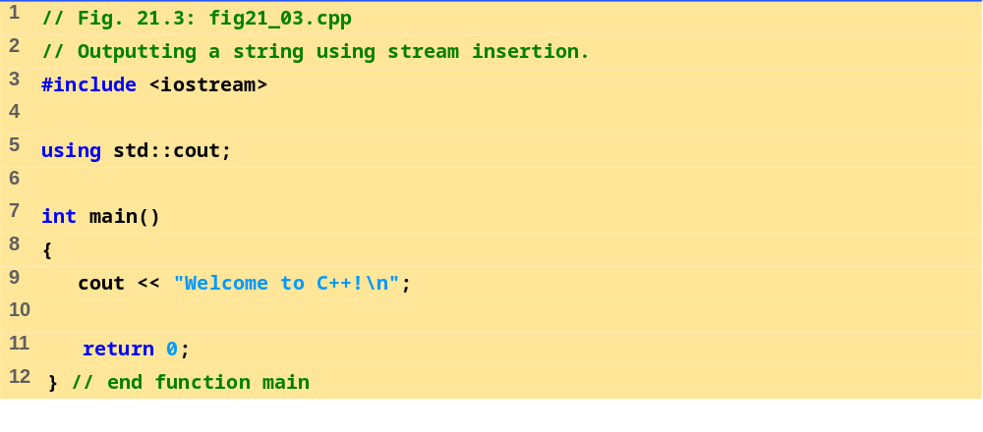
fig21_03.cpp
Program Output
Welcome to C++!

Slide 15
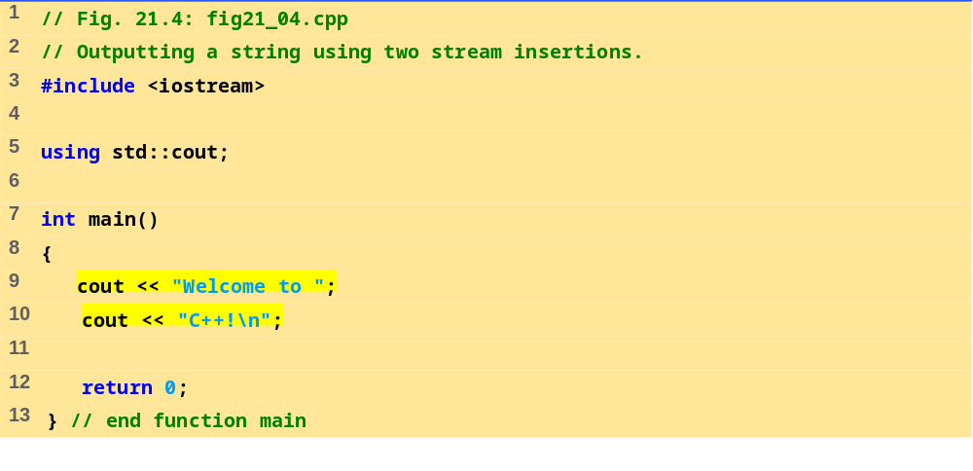
fig21_04.cpp
Program Output
Welcome to C++!

Slide 16
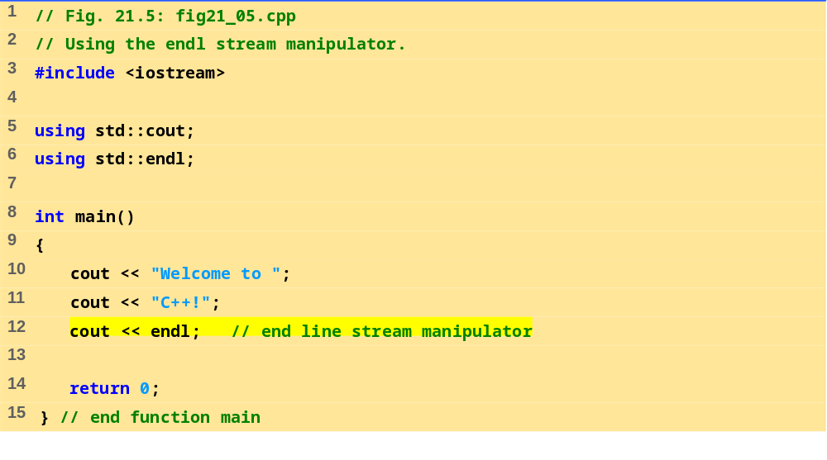
fig21_05.cpp
Program Output
Welcome to C++!

Slide 17
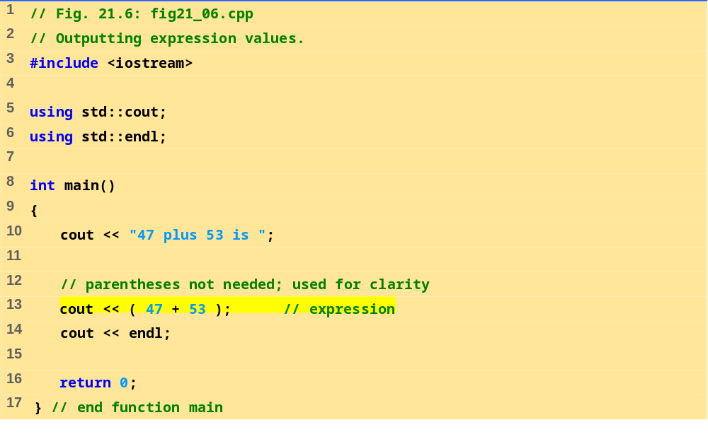
fig21_06.cpp
Program Output
47 plus 53 is 100

Slide 18
21.3.2 Cascading Stream-Insertion/Extraction Operators
<< : Associates from left to right, and returns a reference to its left-operand object (i.e. cout).
  This enables cascading
  cout << "How" << " are" << " you?";
  Make sure to use parenthesis:
  cout << "1 + 2 = " << (1 + 2);
  NOT
  cout << "1 + 2 = " << 1 + 2;

Slide 19
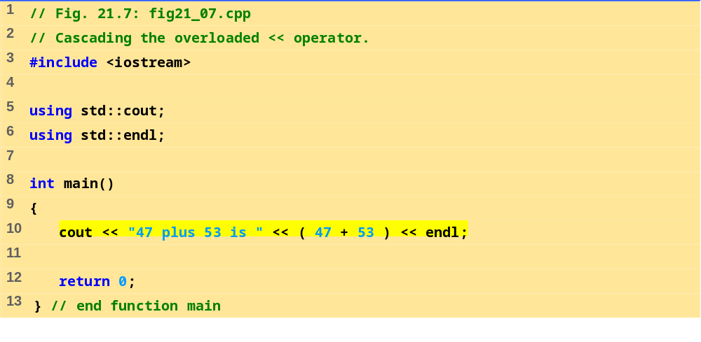
fig21_07.cpp
Program Output
47 plus 53 is 100

Slide 20
21.3.3 Output of char * Variables
<< will output a variable of type char * as a string
To output the address of the first character of that string, cast the variable as type void *

Slide 21
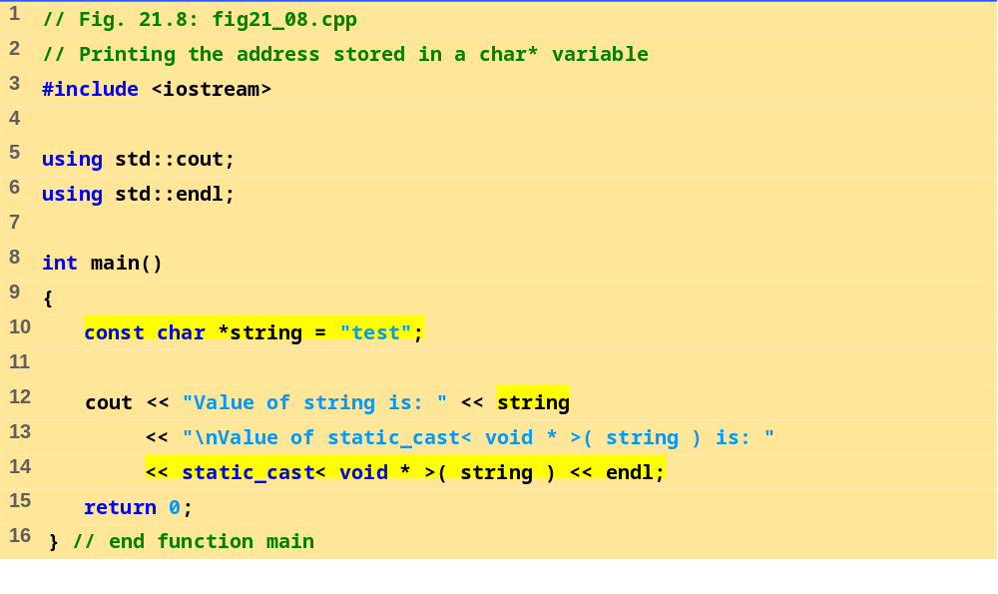
fig21_08.cpp
Program Output
Value of string is: test
Value of static_cast< void *>( string ) is: 0046C070

Slide 22
21.3.4 Character Output with Member Function put; Cascading puts
put member function
  Outputs one character to specified stream
  cout.put( 'A');
  Returns a reference to the object that called it, so may be cascaded
  cout.put( 'A' ).put( '\n' );
  May be called with an ASCII-valued expression
  cout.put( 65 );
    Outputs A

Slide 23
21.4 Stream Input
>> (stream-extraction)
  Used to perform stream input
  Normally ignores whitespaces (spaces, tabs, newlines)
  Returns zero (false) when EOF is encountered, otherwise returns reference to the object from which it was invoked (i.e. cin)
>> controls the state bits of the stream
  failbit set if wrong type of data input
  badbit set if the operation fails

Slide 24
21.4.1 Stream-Extraction Operator
>> and << have relatively high precedence
  Conditional and arithmetic expressions must be contained in parentheses
Popular way to perform loops
  while (cin >> grade)
    Extraction returns 0 (false) when EOF encountered, and loop ends

Slide 25
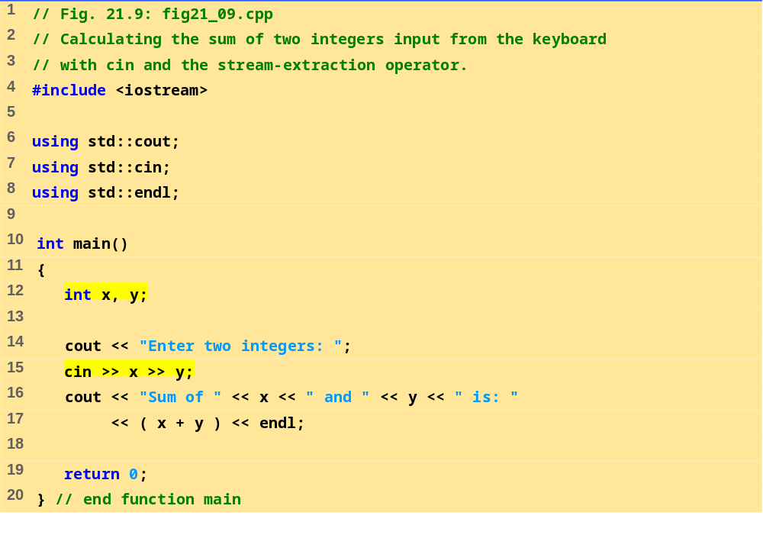
fig21_09.cpp
Program Output
Enter two integers: 30 92
Sum of 30 and 92 is: 122

Slide 26
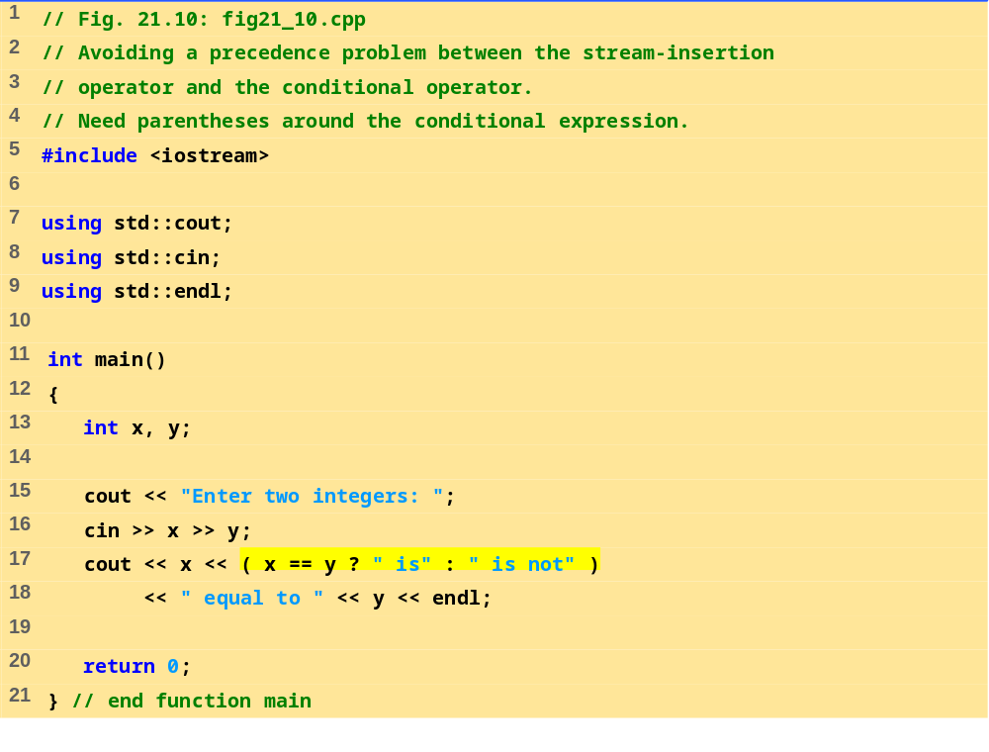
fig21_10.cpp
Program Output
Enter two integers: 7 5
7 is not equal to 5
Enter two integers: 8 8
8 is equal to 8

Slide 27
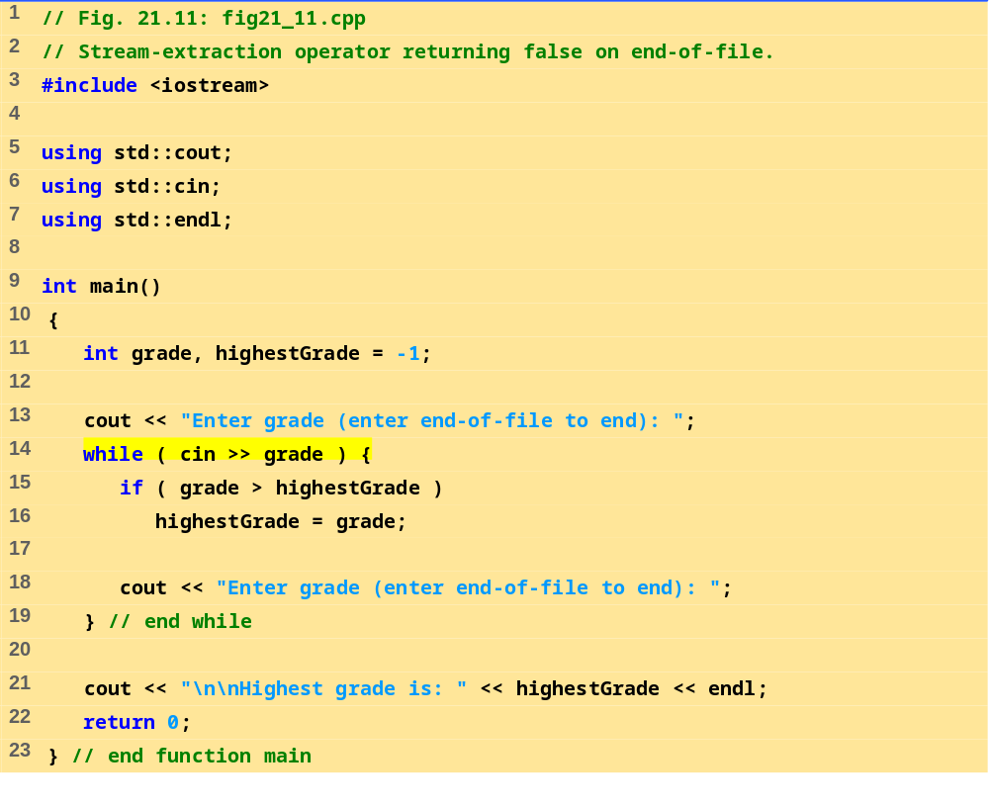
fig21_11.cpp

Slide 28
Enter grade (enter end-of-file to end): 67
Enter grade (enter end-of-file to end): 87
Enter grade (enter end-of-file to end): 73
Enter grade (enter end-of-file to end): 95
Enter grade (enter end-of-file to end): 34
Enter grade (enter end-of-file to end): 99
Enter grade (enter end-of-file to end): ^Z
Highest grade is: 99
Program Output

Slide 29
21.4.2 get and getline Member Functions
cin.eof(): returns true if end-of-file has occurred on cin
cin.get(): inputs a character from stream (even white spaces) and returns it
cin.get( c ): inputs a character from stream and stores it in c

Slide 30
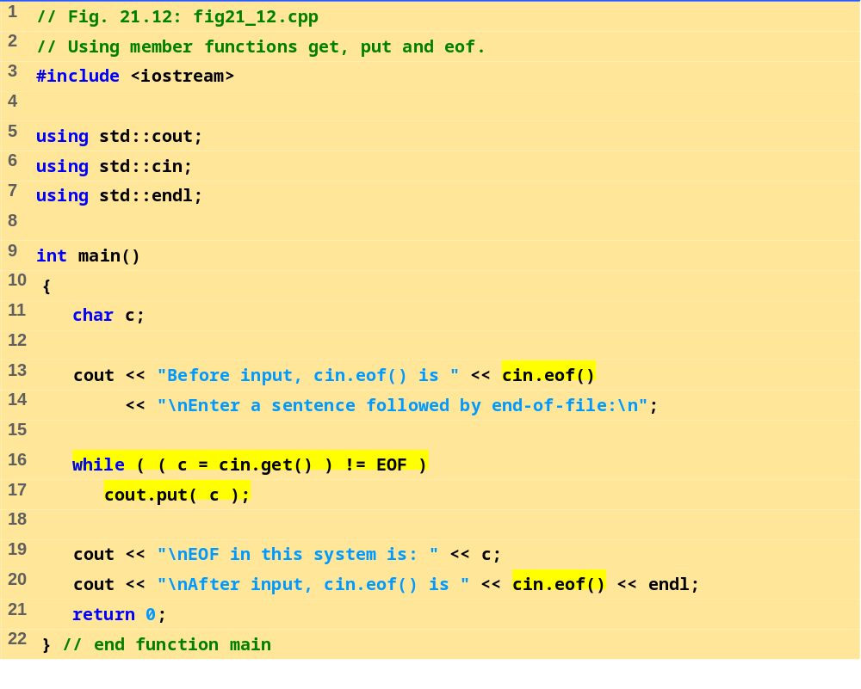
fig21_12.cpp

Slide 31
Before input, cin.eof() is 0
Enter a sentence followed by end-of-file:
Testing the get and put member functions
Testing the get and put member functions
^Z
EOF in this system is: -1
After input cin.eof() is 1
Program Output

Slide 32
21.4.2 get and getline Member Functions
cin.get(array, size):
  Accepts 3 arguments: array of characters, the size limit, and a delimiter ( default of ‘\n’).
  Uses the array as a buffer
  When the delimiter is encountered, it remains in the input stream
  Null character is inserted in the array
  Unless delimiter flushed from stream, it will stay there
cin.getline(array, size)
  Operates like cin.get(buffer, size) but it discards the delimiter from the stream and does not store it in array
  Null character inserted into array

Slide 33
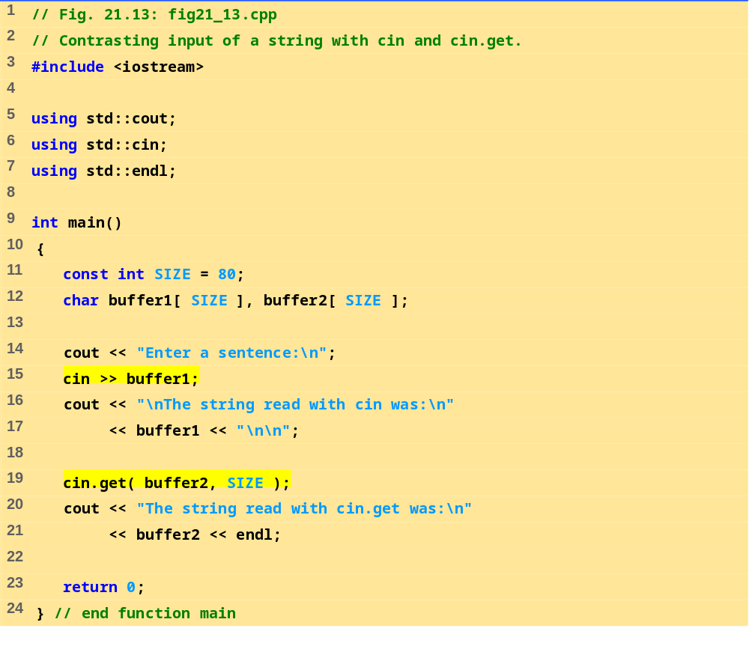
fig21_13.cpp

Slide 34
Enter a sentence:
Contrasting string input with cin and cin.get
The string read with cin was:
Contrasting
The string read with cin.get was:
string input with cin and cin.get
Program Output

Slide 35
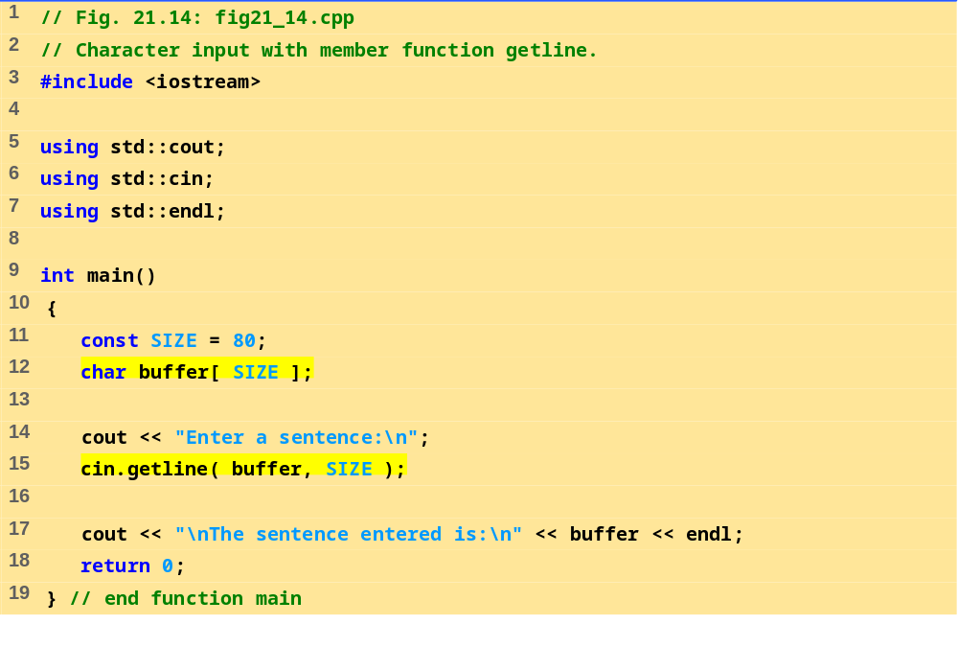
fig21_14.cpp
Program Output
Enter a sentence:
Using the getline member function
The sentence entered is:
Using the getline member function

Slide 36
21.4.3 istream Member Functions peek, putback and ignore
ignore member function
  Skips over a designated number of characters (default of one)
  Terminates upon encountering a designated delimiter (default is EOF, skips to the end of the file)
putback member function
  Places the previous character obtained by get back in to the stream.
peek
  Returns the next character from the stream without removing it

Slide 37
21.4.4 Type-Safe I/O
<< and >> operators
  Overloaded to accept data of different types
  When unexpected data encountered, error flags set
  Program stays in control

Slide 38
21.5 Unformatted I/O with read, gcount and write
read and write member functions
  Unformatted I/O
  Input/output raw bytes to or from a character array in memory
  Since the data is unformatted, the functions will not terminate at a newline character for example
    Instead, like getline, they continue to process a designated number of characters
  If fewer than the designated number of characters are read, then the failbit is set
gcount:
  Returns the total number of characters read in the last input operation

Slide 39
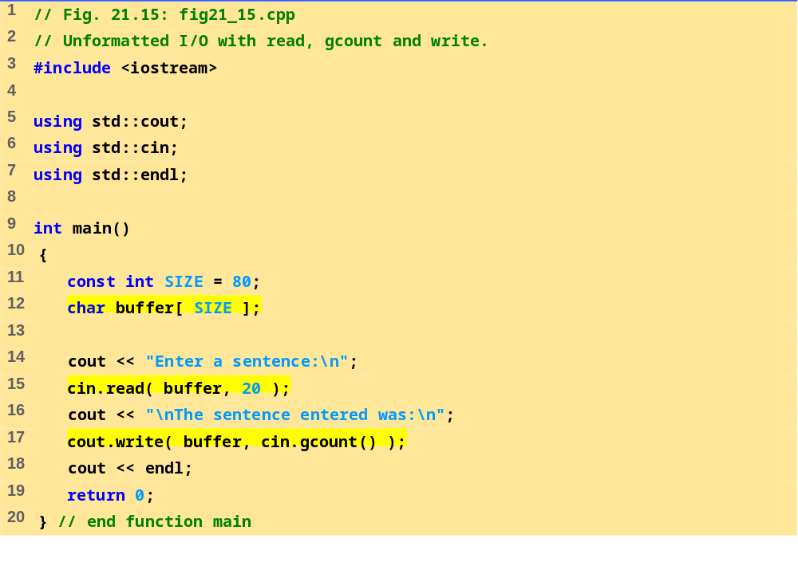
fig21_15.cpp
Program Output
Enter a sentence:
Using the read, write and gcount member functions
The sentence entered was:
Using the read, writ

Slide 40
21.6 Stream Manipulators
Stream manipulator capabilities
  Setting field widths
  Setting precisions
  Setting and unsetting format flags
  Setting the fill character in fields
  Flushing streams
  Inserting a newline in the output stream and flushing the stream
  Inserting a null character in the output stream and skipping whitespace in the input stream

Slide 41
21.6.1 Integral Stream Base: dec, oct, hex and setbase
oct, hex or dec:
  Change base of which integers are interpreted from the stream.
  Example:
  int n = 15;
  cout << hex << n;
  Prints "F"
setbase:
  Changes base of integer output
  Load <iomanip>
  Accepts an integer argument (10, 8, or 16)
  cout << setbase(16) << n;
  Parameterized stream manipulator - takes an argument

Slide 42
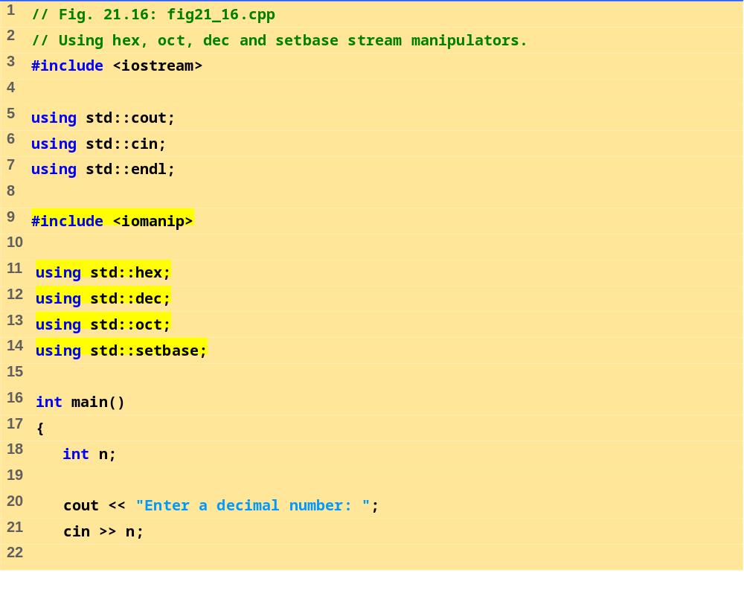
fig21_16.cpp (Part 1 of 2)

Slide 43
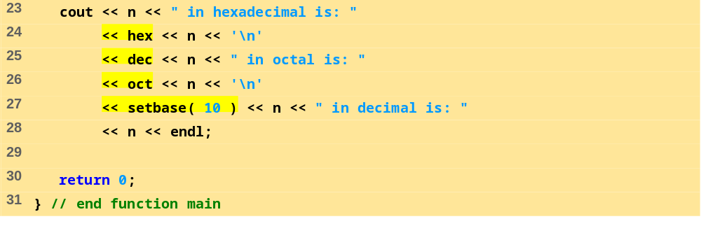
fig21_16.cpp (Part 2 of 2)
Program Output
Enter a decimal number: 20
20 in hexadecimal is: 14
20 in octal is: 24
20 in decimal is: 20

Slide 44
21.6.2 Floating-Point Precision (precision, setprecision)
precision
  Member function
  Sets number of digits to the right of decimal point
  cout.precision(2);
  cout.precision() returns current precision setting
setprecision
  Parameterized stream manipulator
  Like all parameterized stream manipulators, <iomanip> required
  Specify precision:
    cout << setprecision(2) << x;
For both methods, changes last until a different value is set

Slide 45
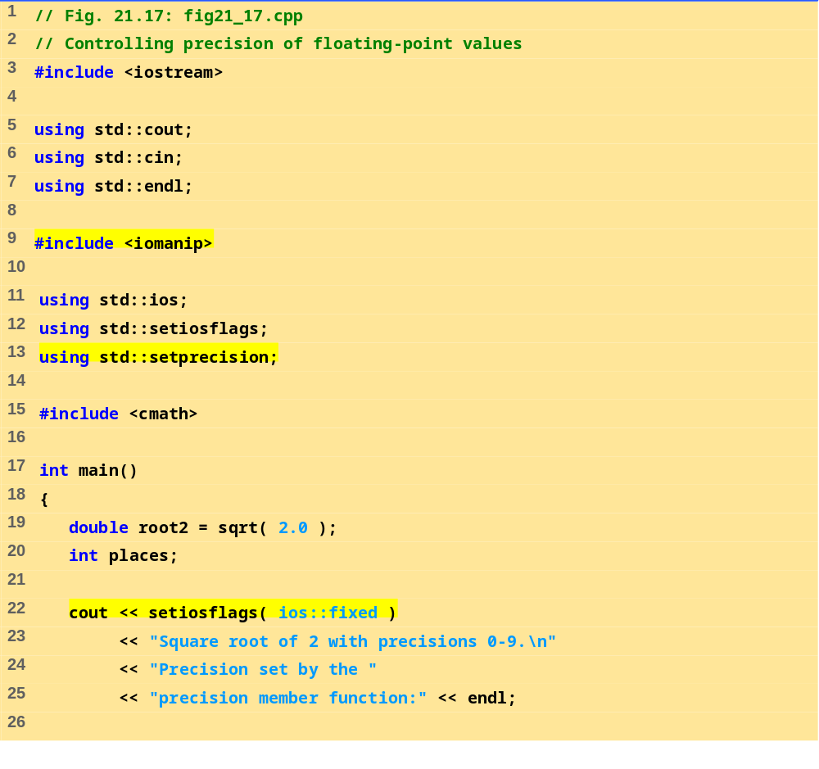
fig21_17.cpp (Part 1 of 2)

Slide 46
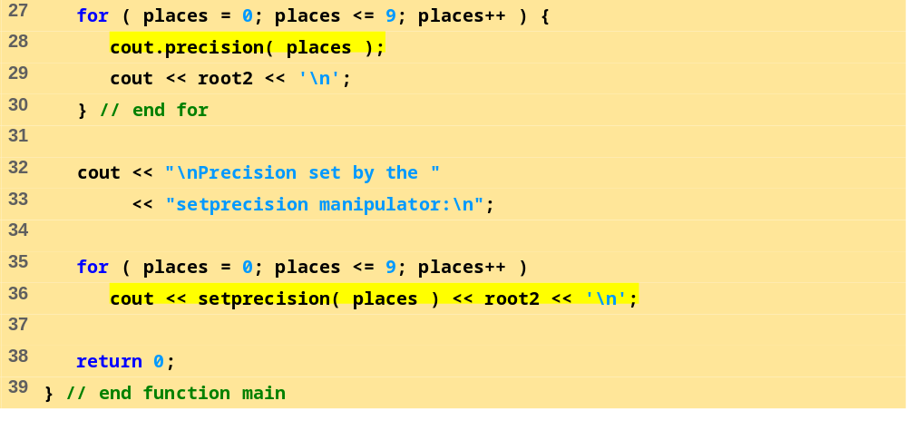
fig21_17.cpp (Part 2 of 2)

Slide 47
Square root of 2 with precisions 0-9.
Precision set by the precision member function:
1
1.4
1.41
1.414
1.4142
1.41421
1.414214
1.4142136
1.41421356
1.414213562
Precision set by the setprecision manipulator:
1
1.4
1.41
1.414
1.4142
1.41421
1.414214
1.4142136
1.41421356
1.414213562
Program Output

Slide 48
21.6.3 Field Width(setw, width)
ios width member function
  Sets field width (number of character positions a value should be output or number of characters that should be input)
  Returns previous width
  If values processed are smaller than width, fill characters inserted as padding
  Values are not truncated - full number printed
  cin.width(5);
setw stream manipulator
  cin >> setw(5) >> string;
Remember to reserve one space for the null character

Slide 49
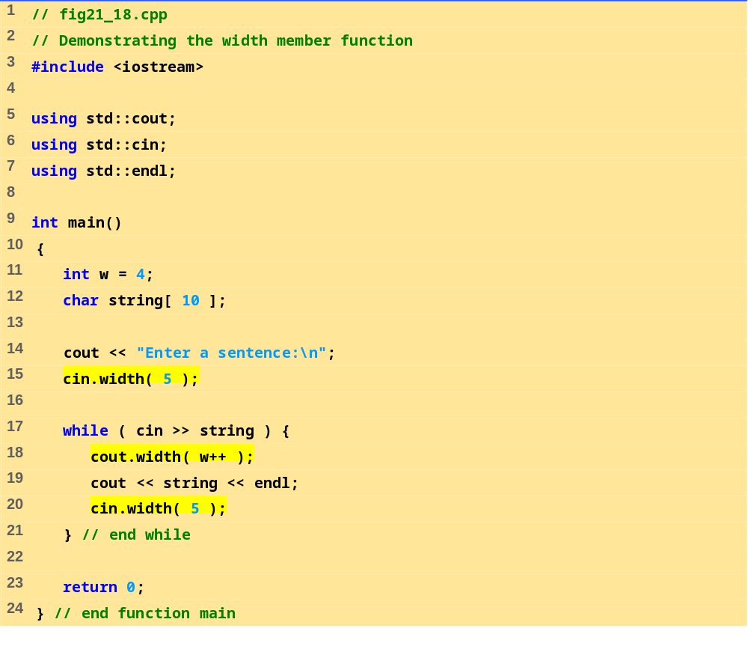
fig21_18.cpp

Slide 50
Enter a sentence:
This is a test of the width member function
This
is
a
test
of
the
widt
h
memb
er
func
tion
Program Output

Slide 51
21.6.4 User-Defined Manipulators
We can create our own stream manipulators
  bell
  ret (carriage return)
  tab
  endLine
Parameterized stream manipulators
  Consult installation manuals

Slide 52
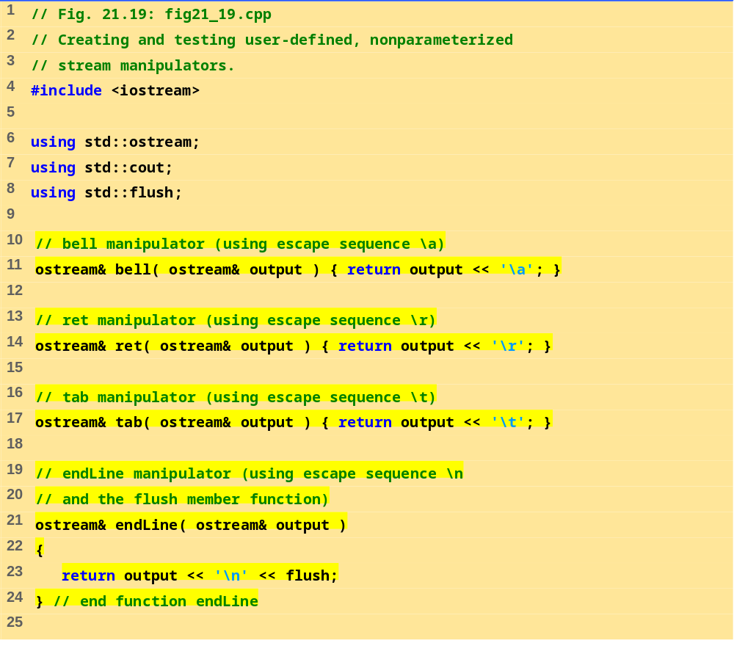
fig21_19.cpp (Part 1 of 2)

Slide 53
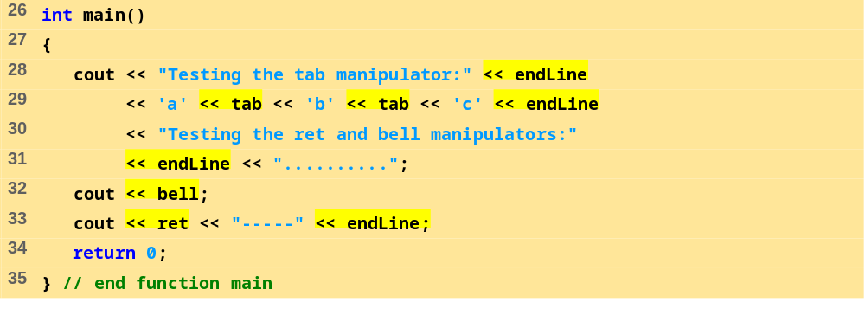
fig21_19.cpp (Part 2 of 2)
Program Output
Testing the tab manipulator:
a b c
Testing the ret and bell manipulators:
-----.....

Slide 54
21.7 Stream Format States
Format flags
  Specify formatting to be performed during stream I/O operations
setf, unsetf and flags
  Member functions that control the flag settings

Slide 55
21.7.1 Format State Flags
Format State Flags
  Defined as an enumeration in class ios
  Can be controlled by member functions
  flags - specifies a value representing the settings of all the flags
    Returns long value containing prior options
  setf - one argument, "ors" flags with existing flags
  unsetf - unsets flags
  setiosflags - parameterized stream manipulator used to set flags
  resetiosflags - parameterized stream manipulator, has same functions as unsetf
Flags can be combined using bitwise OR ( | )

Slide 56
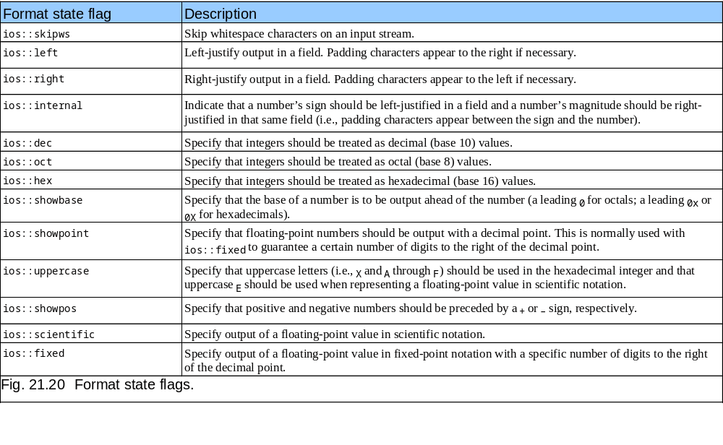
21.7.1 Format State Flags

Slide 57
21.7.2 Trailing Zeros and Decimal Points (ios::showpoint)
ios::showpoint
  Forces a float with an integer value to be printed with its decimal point and trailing zeros
  cout.setf(ios::showpoint)
  cout << 79;
  79 will print as 79.00000
    Number of zeros determined by precision settings

Slide 58
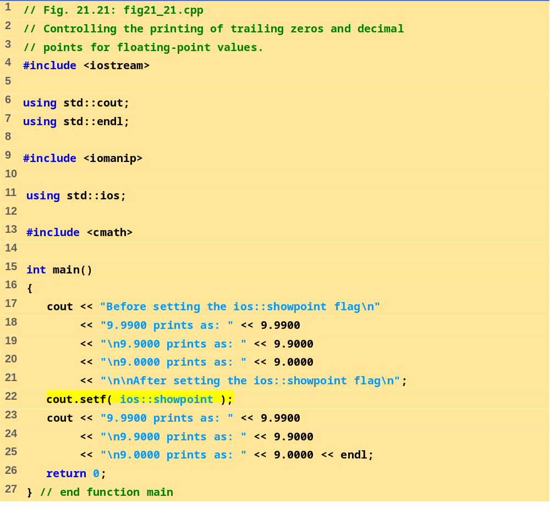
fig21_21.cpp

Slide 59
Before setting the ios::showpoint flag
9.9900 prints as: 9.99
9.9000 prints as: 9.9
9.0000 prints as: 9
After setting the ios::showpoint flag
9.9900 prints as: 9.99000
9.9000 prints as: 9.90000
9.0000 prints as: 9.00000
Program Output

Slide 60
21.7.3 Justification (ios::left, ios::right, ios::internal)
ios::left
  Fields to left-justified with padding characters to the right
ios::right
  Default setting
  Fields right-justified with padding characters to the left
Character used for padding set by
  fill member function
  setfill parameterized stream manipulator
  Default character is space

Slide 61
21.7.3 Justification (ios::left, ios::right, ios::internal)
internal flag
  Number’s sign left-justified
  Number’s magnitude right-justified
  Intervening spaces padded with the fill character
static data member ios::adjustfield
  Contains left, right and internal flags
  ios::adjustfield must be the second argument to setf when setting the left, right or internal justification flags
  cout.setf( ios::left, ios::adjustfield);

Slide 62
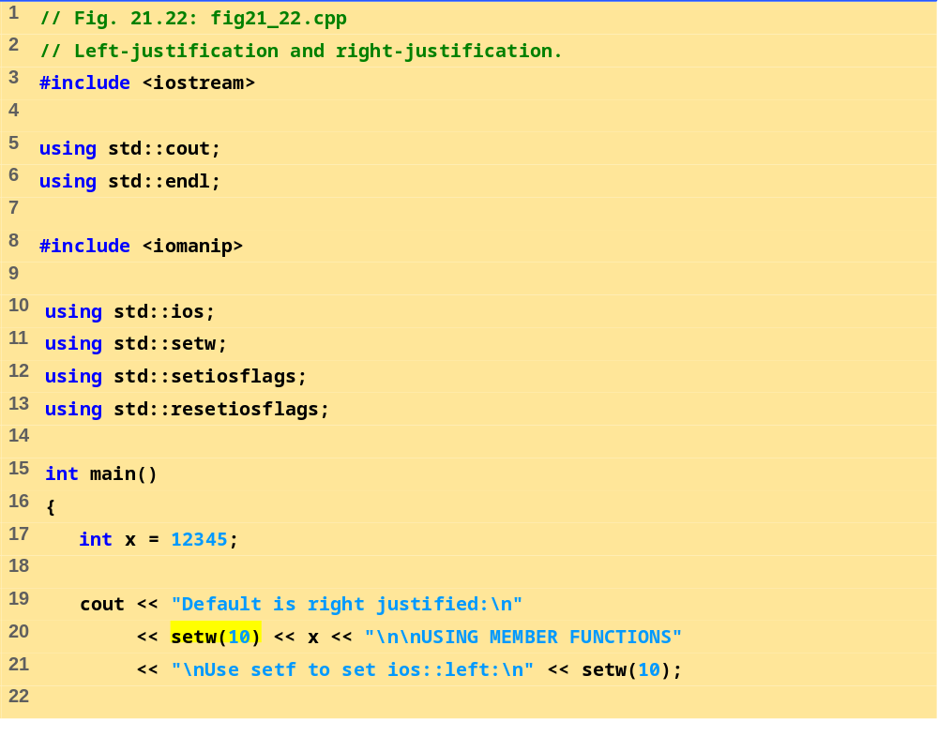
fig21_22.cpp (Part 1 of 2)

Slide 63
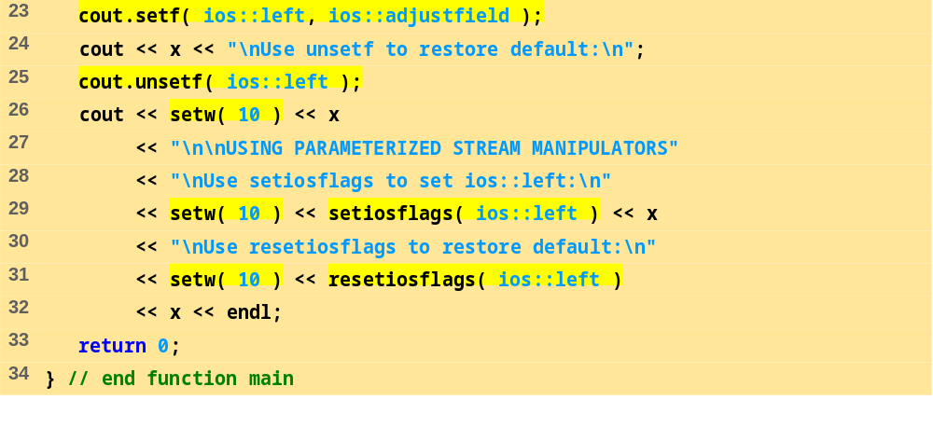
fig21_22.cpp (Part 2 of 2)
Program Output
Default is right justified:
12345
USING MEMBER FUNCTIONS
Use setf to set ios::left:
12345
Use unsetf to restore default:
12345
USING PARAMETERIZED STREAM MANIPULATORS
Use setiosflags to set ios::left:
12345
Use resetiosflags to restore default:
12345

Slide 64
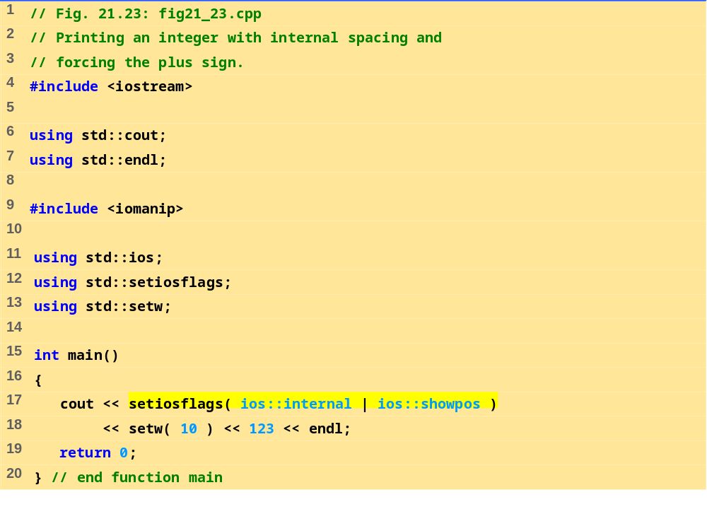
fig21_23.cpp
Program Output
+ 123

Slide 65
21.7.4 Padding (fill, setfill)
fill member function
  Specifies the fill character
  Space is default
  Returns the prior padding character
  cout.fill('*');
setfill manipulator
  Also sets fill character
  cout << setfill ('*');

Slide 66
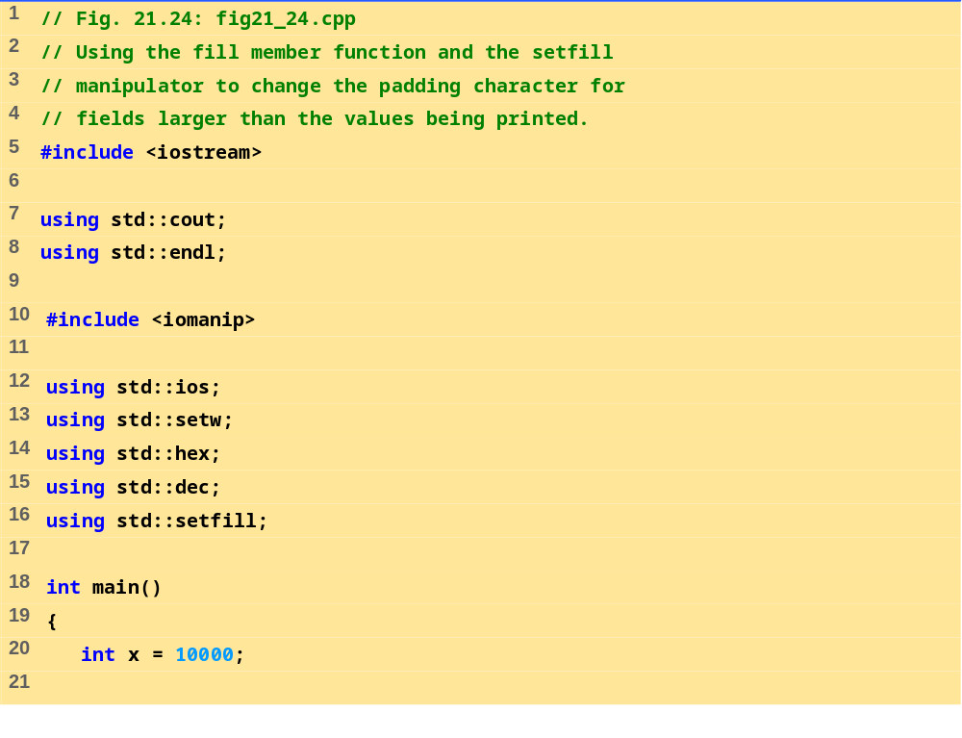
fig21_24.cpp (Part 1 of 2)

Slide 67
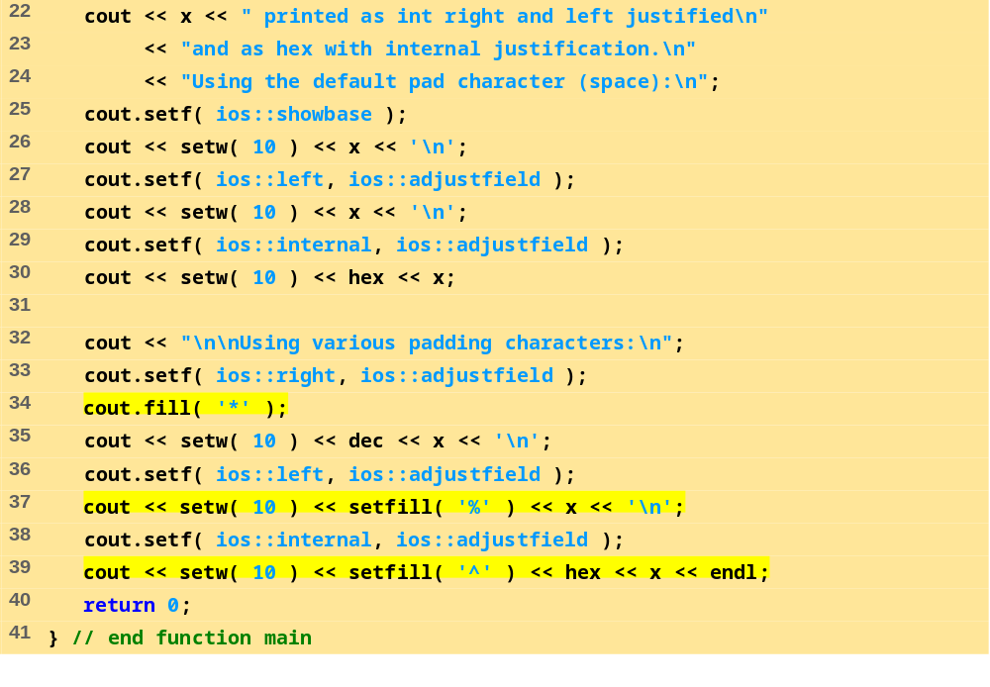
fig21_24.cpp (Part 1 of 2)
Program Output
10000 printed as int right and left justified
and as hex with internal justification.
Using the default pad character (space):
10000
10000
0x 2710
Using various padding characters:
*****10000
10000%%%%%
0x^^^^2710

Slide 68
21.7.5- Integral Stream Base (ios::dec, ios::oct, ios::hex, ios::showbase)
ios::basefield static member
  Used similarly to ios::adjustfield with setf
  Includes the ios::oct, ios::hex and ios::dec flag bits
  Specify that integers are to be treated as octal, hexadecimal and decimal values
  Default is decimal
  Default for stream extractions depends on form inputted
    Integers starting with 0 are treated as octal
    Integers starting with 0x or 0X are treated as hexadecimal
  Once a base specified, settings stay until changed

Slide 69
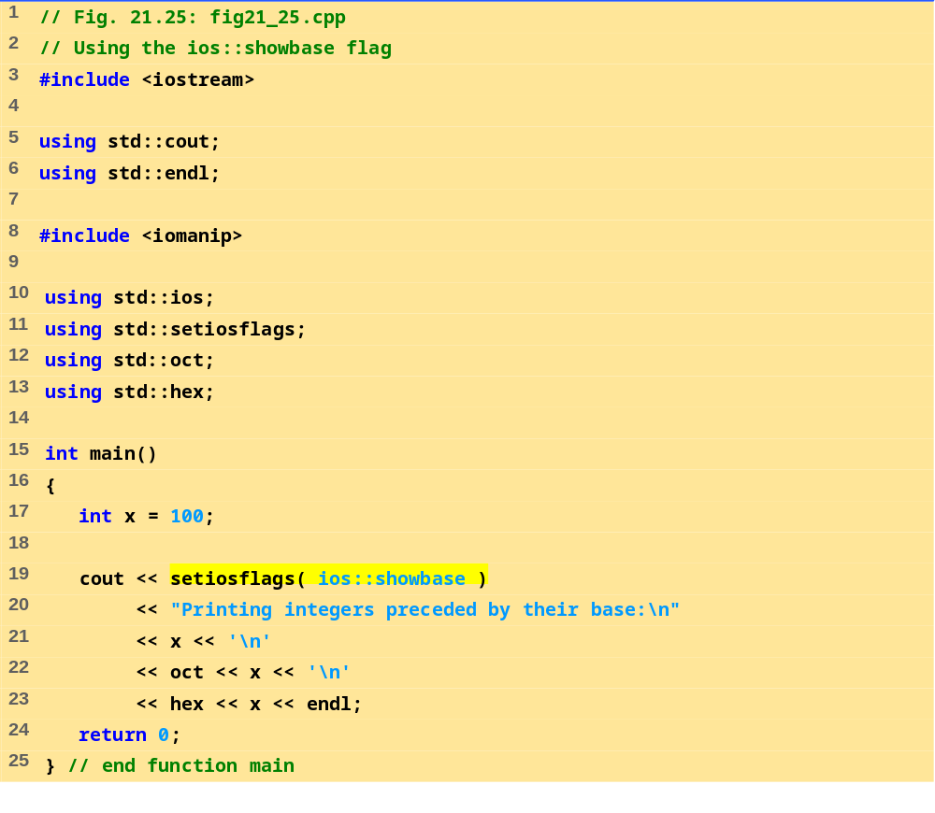
fig21_25.cpp
Program Output
Printing integers preceded by their base:
100
0144
0x64

Slide 70
21.7.6 Floating-Point Numbers; Scientific Notation (ios::scientific, ios::fixed)
ios::scientific
  Forces output of a floating point number in scientific notation:
    1.946000e+009
ios::fixed
  Forces floating point numbers to display a specific number of digits to the right of the decimal (specified with precision)

Slide 71
21.7.6 Floating-Point Numbers; Scientific Notation (ios::scientific, ios::fixed)
static data member ios::floatfield
  Contains ios::scientific and ios::fixed
  Used similarly to ios::adjustfield and ios::basefield in setf
    cout.setf(ios::scientific, ios::floatfield);
  cout.setf(0, ios::floatfield) restores default format for outputting floating-point numbers

Slide 72
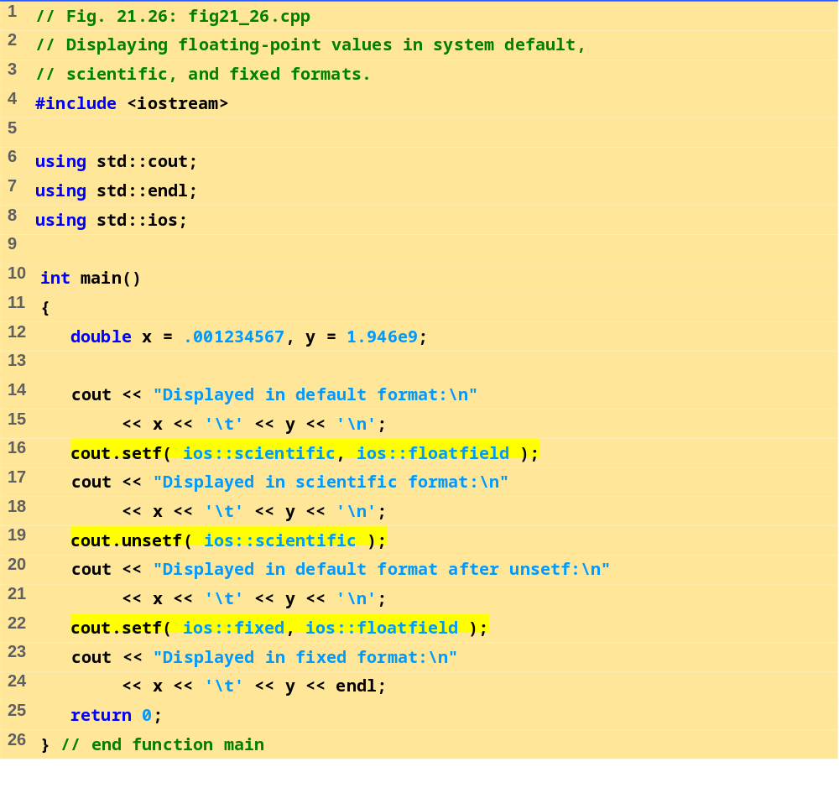
fig21_26.cpp

Slide 73
Displayed in default format:
0.00123457 1.946e+009
Displayed in scientific format:
1.234567e-003 1.946000e+009
Displayed in default format after unsetf:
0.00123457 1.946e+009
Displayed in fixed format:
0.001235 1946000000.000000
Program Output

Slide 74
21.7.7 Uppercase/Lowercase Control (ios::uppercase)
ios::uppercase
  Forces uppercase E to be output with scientific notation
  4.32E+010
  Forces uppercase X to be output with hexadecimal numbers, and causes all letters to be uppercase
  75BDE

Slide 75
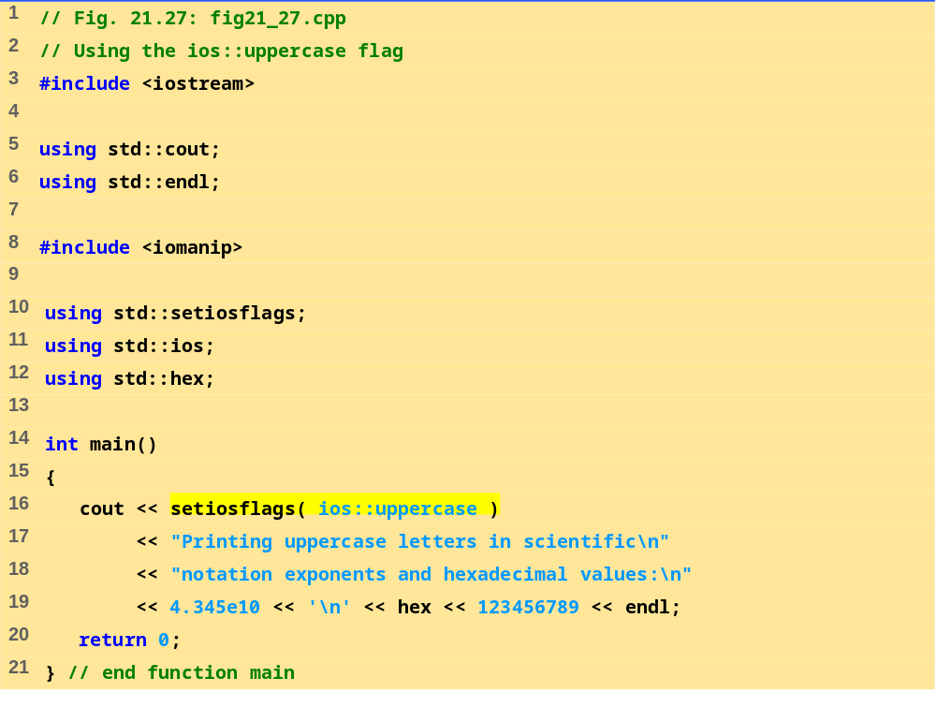
fig21_27.cpp
Program Output
Printing uppercase letters in scientific
notation exponents and hexadecimal values:
4.345E+010
75BCD15

Slide 76
21.7.8 Setting and Resetting the Format Flags (flags, setiosflags, resetiosflags)
flags member function
  Without argument, returns the current settings of the format flags (as a long value)
  With a long argument, sets the format flags as specified
    Returns prior settings
setf member function
  Sets the format flags provided in its argument
  Returns the previous flag settings as a long value
  Unset the format using unsetf member function
  long previousFlagSettings =
  cout.setf( ios::showpoint | ios::showpos );

Slide 77
21.7.8 Setting and Resetting the Format Flags (flags, setiosflags, resetiosflags)
setf with two long arguments
  cout.setf( ios::left, ios::adjustfield );
  clears the bits of ios::adjustfield then sets ios::left
  This version of setf can be used with
  ios::basefield (ios::dec, ios::oct, ios::hex)
  ios::floatfield (ios::scientific, ios::fixed)
  ios::adjustfield (ios::left, ios::right, ios::internal )
unsetf
  Resets specified flags
  Returns previous settings

Slide 78
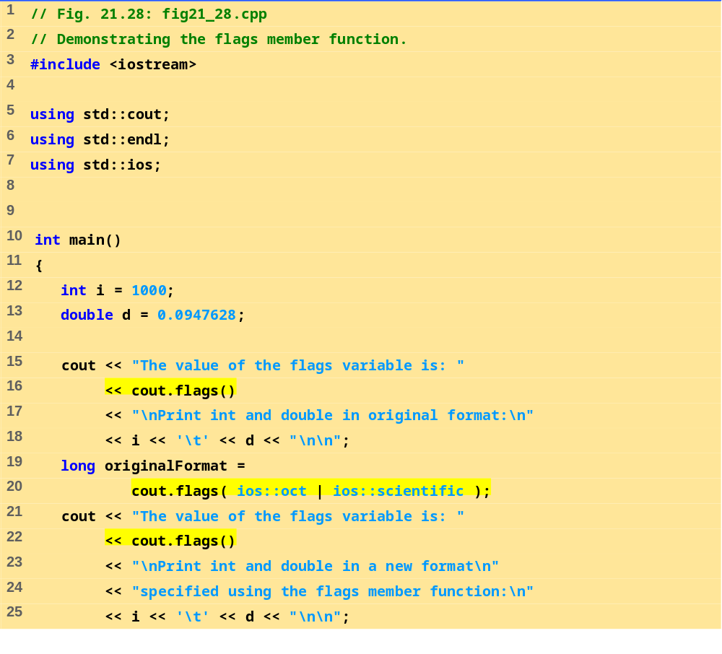
fig21_28.cpp (Part 1 of 2)

Slide 79
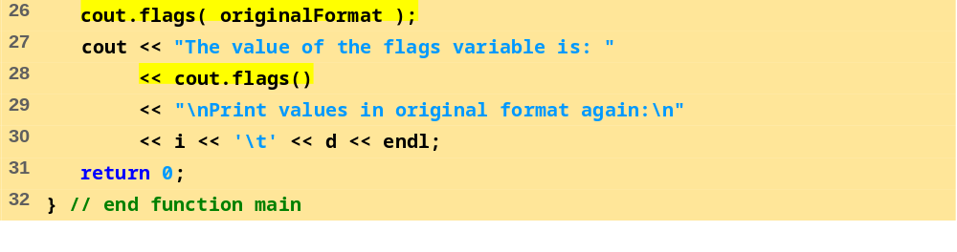
fig21_28.cpp (Part 2 of 2)
Program Output
The value of the flags variable is: 513
Print int and double in original format:
1000 0.0947628
The value of the flags variable is: 12000
Print int and double in a new format
specified using the flags member function:
1750 9.476280e-002
The value of the flags variable is: 513
Print values in original format again:
1000 0.0947628

Slide 80
21.8 Stream Error States
eofbit
  Set for an input stream after end-of-file encountered
  cin.eof() returns true if end-of-file has been encountered on cin
failbit
  Set for a stream when a format error occurs
  cin.fail() - returns true if a stream operation has failed
  Normally possible to recover from these errors

Slide 81
21.8 Stream Error States
badbit
  Set when an error occurs that results in data loss
  cin.bad() returns true if stream operation failed
  normally nonrecoverable
goodbit
  Set for a stream if neither eofbit, failbit or badbit are set
  cin.good() returns true if the bad, fail and eof functions would all return false.
  I/O operations should only be performed on “good” streams
rdstate
  Returns the state of the stream
  Stream can be tested with a switch statement that examines all of the state bits
  Easier to use eof, bad, fail, and good to determine state

Slide 82
21.8 Stream Error States
clear
  Used to restore a stream’s state to “good”
  cin.clear() clears cin and sets goodbit for the stream
  cin.clear( ios::failbit ) actually sets the failbit
    Might do this when encountering a problem with a user-defined type
Other operators
  operator!
    Returns true if badbit or failbit set
  operator void*
    Returns false if badbit or failbit set
  Useful for file processing

Slide 83
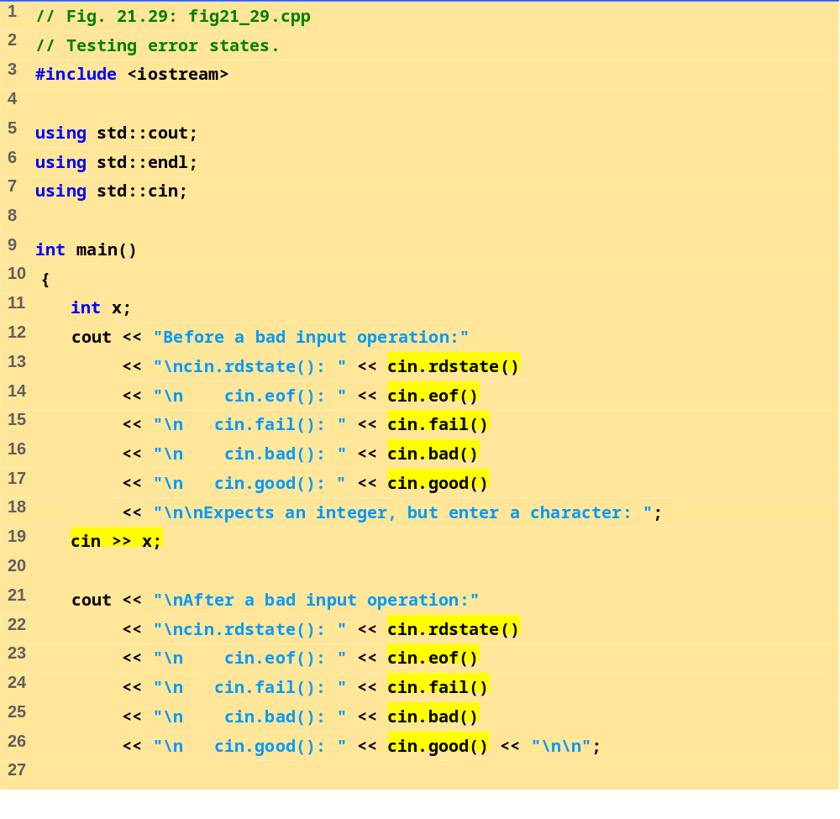
fig21_29.cpp (Part 1 of 2)

Slide 84
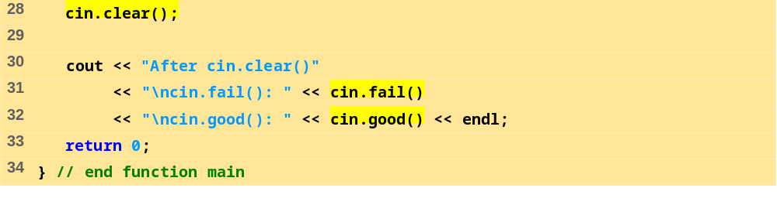
fig21_29.cpp (Part 2 of 2)
Program Output
Before a bad input operation:
cin.rdstate(): 0
cin.eof(): 0
cin.fail(): 0
cin.bad(): 0
cin.good(): 1
Expects an integer, but enter a character: A
After a bad input operation:
cin.rdstate(): 2
cin.eof(): 0
cin.fail(): 1
cin.bad(): 0
cin.good(): 0
After cin.clear()
cin.fail(): 0
cin.good(): 1

Slide 85
21.9 Tying an Output Stream to an Input Stream
tie member function
  Synchronize operation of an istream and an ostream
  Outputs appear before subsequent inputs
  Automatically done for cin and cout
inputStream.tie( &outputStream );
  Ties inputStream to outputStream
  cin.tie( &cout) done automatically
inputStream.tie( 0 );
  Unties inputStream from an output stream

